Slide 1
TEAM FOURTRESS
PM REVIEW

Slide 2
FUNCTIONALITIES
INSERT FUNCTIONALITY WHERE FUNCTION = NONE;
DROP FUNCTIONALITY WHERE FUNCTION = NONE;

Slide 3
FRAMEWORK
JSP MODEL 2
USAGE OF MODEL-VIEW-CONTROLLER ARCHITECTURE
ITERATIVE TIME-BOXING
INTEGRATION WITH OTHER FUNCTIONALITIES TO BE CARRIED OUT BY THE END OF EVERY ITERATION

Slide 4
SCHEDULE
WEEK 5- COMPLETE DIAGRAMS AND SCHEDULING
WEEK 6 - COMPLETE LOGIN
WEEK 7 - COMPLETE BOOTSTRAP
WEEK 8 - COMPLETE BASIC LOCATION REPORTS
WEEK 9 - COMPLETE HEATMAP & AUTOMATIC GROUP IDENTIFICATION
WEEK 10 - COMPLETE DUAL INTERFACE
WEEK 11- COMPLETE ALL FUNCTIONALITIES
WEEK 12 – UAT
WEEK 13 – FINAL ADJUSTMENTS
WEEK 14 - FINAL PRESENTATION

Slide 5
ITERATIONS
6 ITERATIONS
ITERATIVE TIME-BOXING
14 Days (2 Weeks)

Slide 6
ITERATION 1
INFORMATION GATHERING
UNDERSTANDING PROJECT REQUIREMENTS
PLAN PROJECT SCHEDULES
USE CASE DIAGRAM + LOGICAL DIAGRAM
PLANNING PROJECT STRUCTURE
WEEK 3 - WEEK 4 (07/09/17 - 21/09/17)

Slide 7
ITERATION 2
LOGIN & VALIDATION
CLASS & SEQUENCE DIAGRAM
UI FOR LOGIN
VALIDATION LOGIC
CONNECTION TO MYSQL DATABASE
START ON BOOTSTRAPPING
WEEK 5 (21/09/2017) - WEEK 6 (05/10/2017)

Slide 8
ITERATION 3
BLR, BOOTSTRAP & AGI
PAIR PROGRAMMING
BASIC LOCATION REPORTS
BOOTSTRAP
DISCUSSION ON HEATMAP IMPLEMENTATION
START ON AGI
COMPLETE BOOTSTRAP
WEEK 7 (05/10/2017) - WEEK 8 (19/10/2017)

Slide 9
ITERATION 4
HEATMAP, AGI AND DUAL UI
COMPLETE HEATMAP
COMPLETE AGI
BEGIN DUAL INTERFACE (JSON)
WEEK 9 (19/10/2017) - WEEK 10 (02/11/2017)

Slide 10
ITERATION 5
WRAPPING UP
DUAL UI (COMPLETE ALL CSS, JS & JSON)
FINAL PROJECT INTEGRATION
RIGOROUS TESTING FOR BUGS
COMPLETION BY 5 NOVEMBER
WEEK 11 (02/11/2017) - WEEK 12 (16/11/2017)

Slide 11
ITERATION 6
REFINEMENT
REVIEWING ON UAT COMMENTS
IMPROVING OUR SYSTEM BASED ON IT
WEEK 13 (16/11/2017 – 23/11/2017)

Slide 12
MILESTONES
PM REVIEW (WEEK 7)
APPLICATION DEMO AND PROGRESS UPDATE (WEEK 10)
UAT (WEEK 12)
FINAL PRESENTATION (WEEK 14)

Slide 13
BUFFER TIME
ITERATION 1
12/09/2017 - 20/09/2017
ITERATION 2
29/09/2017 - 4/10/2017
ITERATION 3
13/10/2017 - 18/10/2017
ITERATION 4
29/10/2017 - 01/11/2017
ITERATION 5
10/11/2017 - 15/11/2017

Slide 14
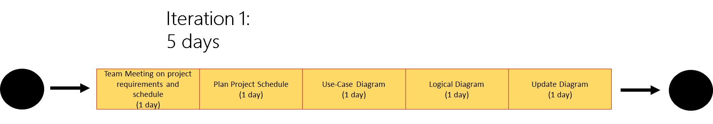
CRITICAL PATH

Slide 15
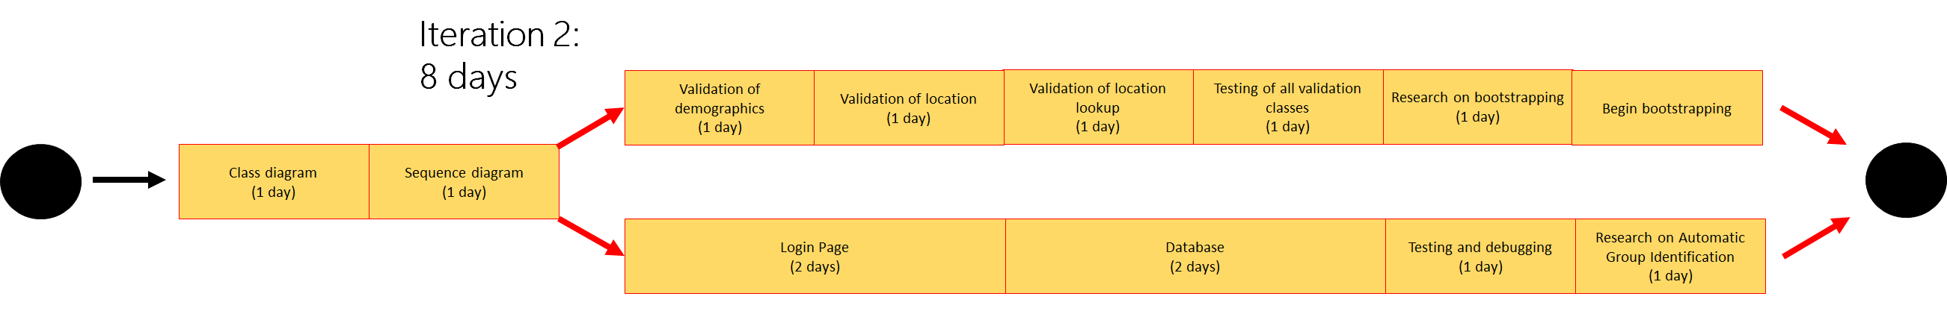
CRITICAL PATH

Slide 16
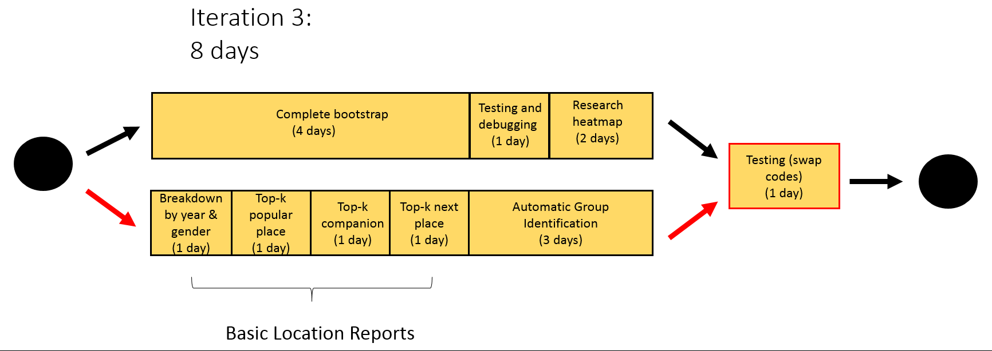
CRITICAL PATH

Slide 17
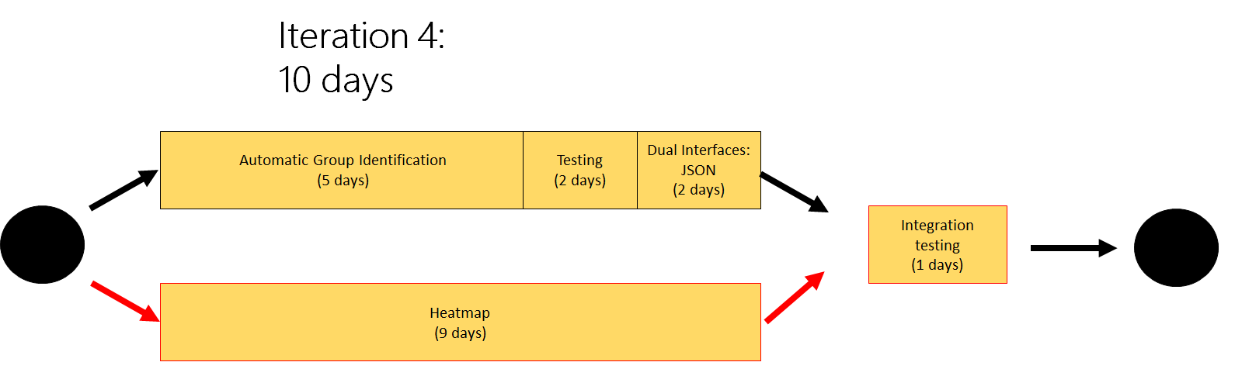
CRITICAL PATH

Slide 18
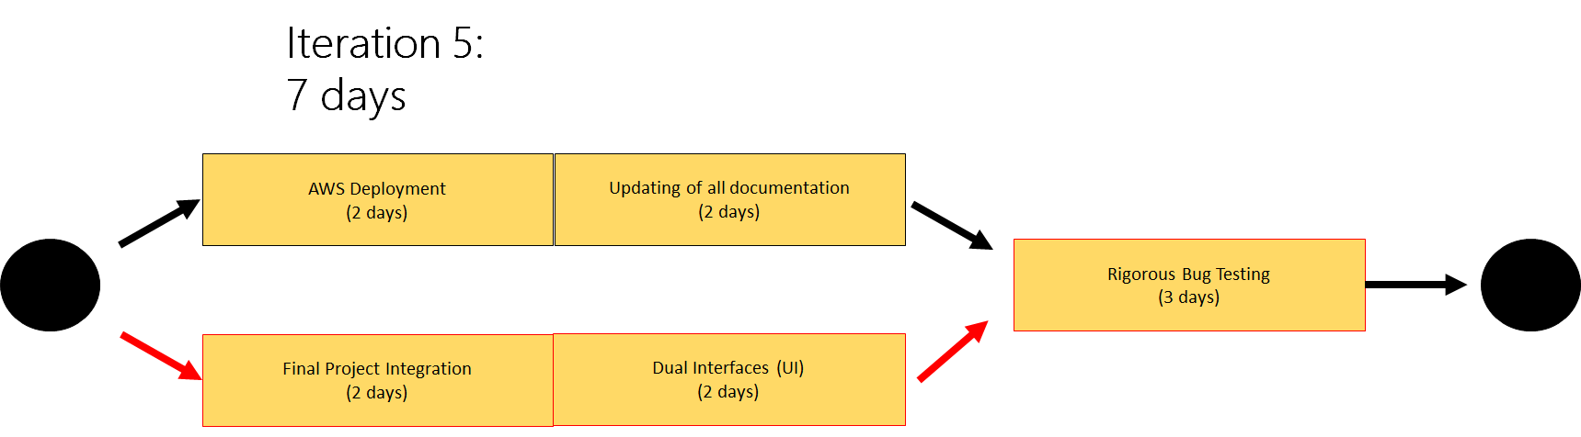
CRITICAL PATH

Slide 19
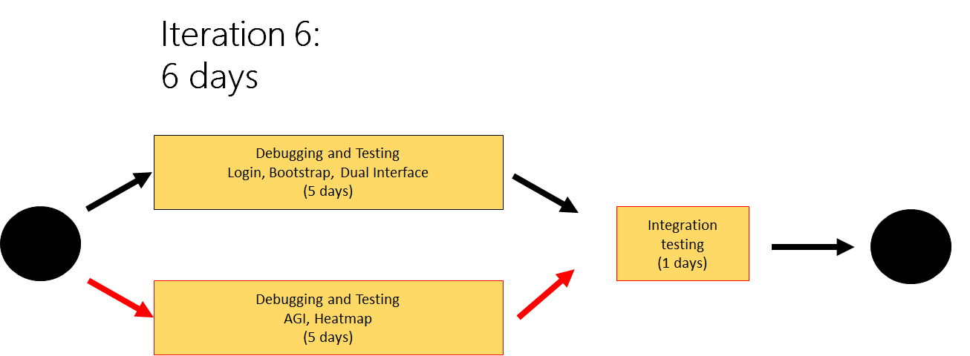
CRITICAL PATH

Slide 20
SCHEDULE METRICS
No Schedule metrics as Team Fourtress is using Time-boxing

Slide 21
BUG METRICS
S/N | Iteration | Date found | Programming task | Bug(s) | Level of impact | Points | Resolved? | Cumulative Points to date | Current unmitigated score
1 | 2 | 28/9/2017 | Validation of demographics.csv | Validation for email testing failed | Low impact | 1 | Yes | 1 | 0
2 | 3 | 4/10/2017 | Login | Exception thrown during login with invalid username | High impact | 5 | Yes | 6 | 0
Course of action: Immediate debugging during PP

Slide 22
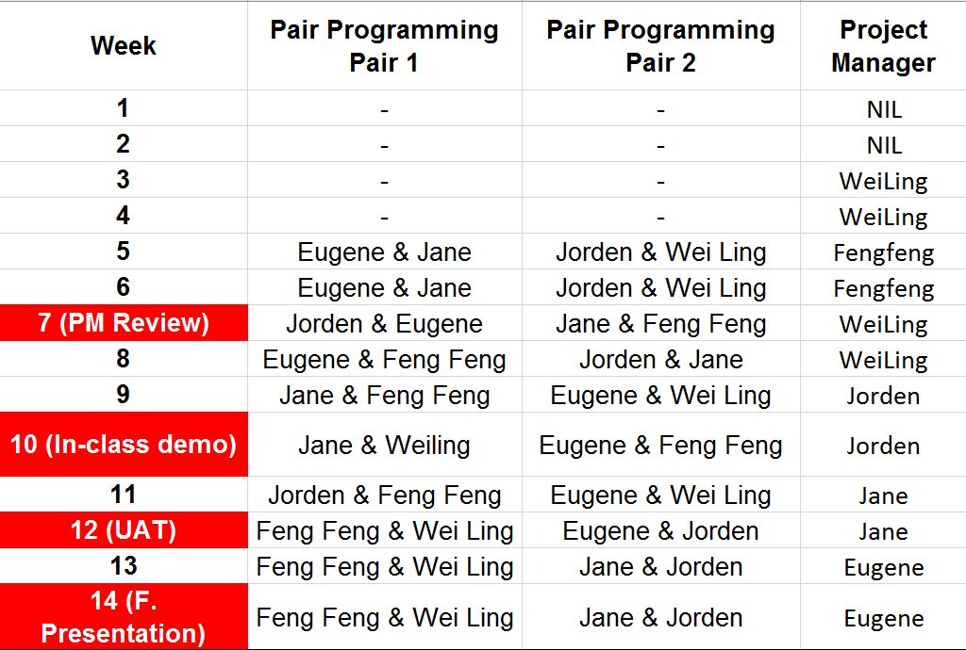
PP/PM SCHEDULE

Slide 23
FOURTRESS OUT

